Slide 1
Designing & Consuming REST API’s
Aim of this slide presentation is to detail out the aspects I find were of importance while designing API’s.
Alongside the above, this presentation also elaborates on the steps to test driven development consuming the REST APIs returning a JSON response. The screenshots of JUnits and @RestController classes along with Spring MVC classes are from the Redhat Fuse IDE.

Slide 2
The aspects I felt helpful while designing REST API’s are:
Functional requirements as BDD feature files with Given..When..Then.. to generate the Cucumber JUnit stubs. Implementing the steps in the JUnit stubs also means a feel for the need of Java classes/objects to design REST API verbs.
Screen designs and screenflow navigations to understand the server side interactions especially the submit buttons to derive implementation of REST API verbs. Example: Soft deletes instead of hard.
Details about interactions between systems and applications for data integrity and data queues.
CRUD database operations of Create, Read, Update, Delete to design the endpoints and the REST API verbs of GET, POST, etc.
Protocols to communicate to design the data binding protocol in the REST WADL. Example: HTTP, TCP/IP.
Non Functional aspects of Security, Concurrency, Multi Threading, Data Integrity, and Error handling.

Slide 3
2. Consuming REST API’s
Spring Model View Controller. The Web Controller class in turn calling the @RestController which consumes the API ensuring there is no duplication of code between the Spring MVC controller and the Rest Controller.
restTemplate.getForObject(url, String.class)).toString();
On this occasion, the JSON returned for searching a list of all the employees was,
{"status":"success","data":[{"id":"1","employee_name":"Tiger Nixon","employee_salary":"320800","employee_age":"61","profile_image":""},{"id":"2","employee_name":"Garrett Winters","employee_salary":"170750","employee_age":"63","profile_image":""}]}

Slide 4
3. The Rest Controller class to fetch the list of all the employees from REST API Endpoint: http://dummy.restapiexample.com/api/v1/employees and the RequestMethod verb GET
@Component
@RestController
public class EmployeeRESTController {
//@Autowired
RestTemplate restTemplate = new RestTemplate();
@RequestMapping(value = "http://dummy.restapiexample.com/api/v1/employees", method = RequestMethod.GET)
public String getAllEmployees() {
String url = "http://dummy.restapiexample.com/api/v1/employees";
return (restTemplate.getForObject(url, String.class)).toString();
}
}

Slide 5
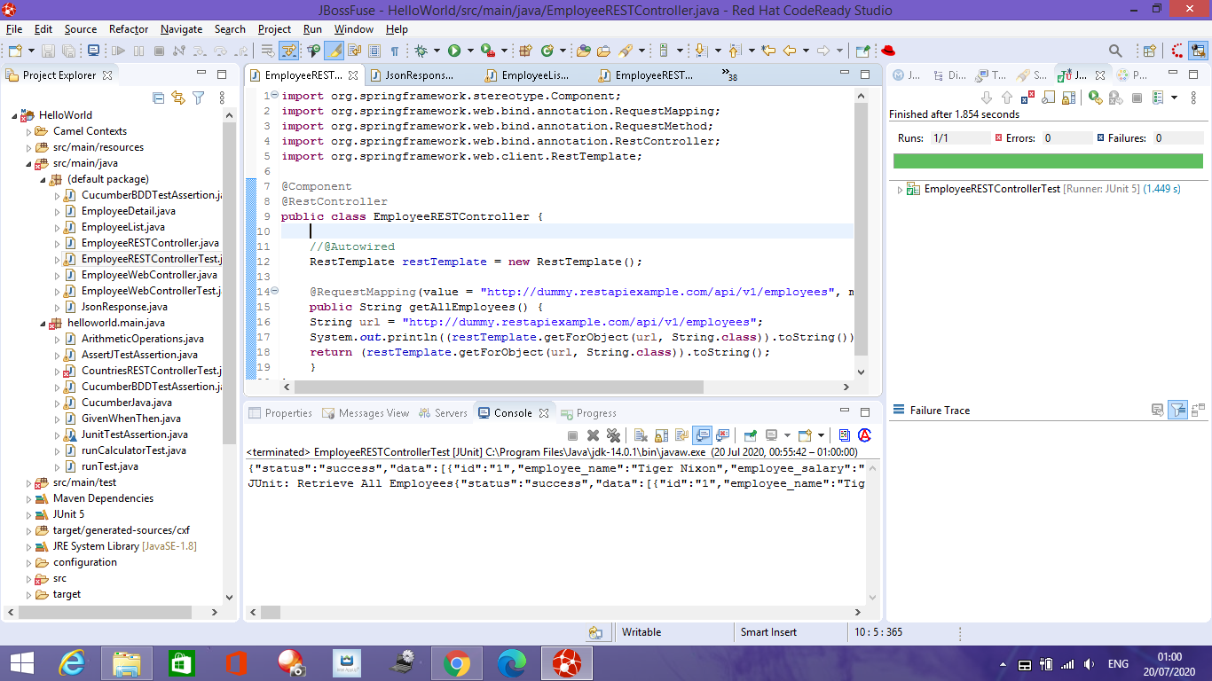
4. RestController JUnit returning a JSON Response

Slide 6
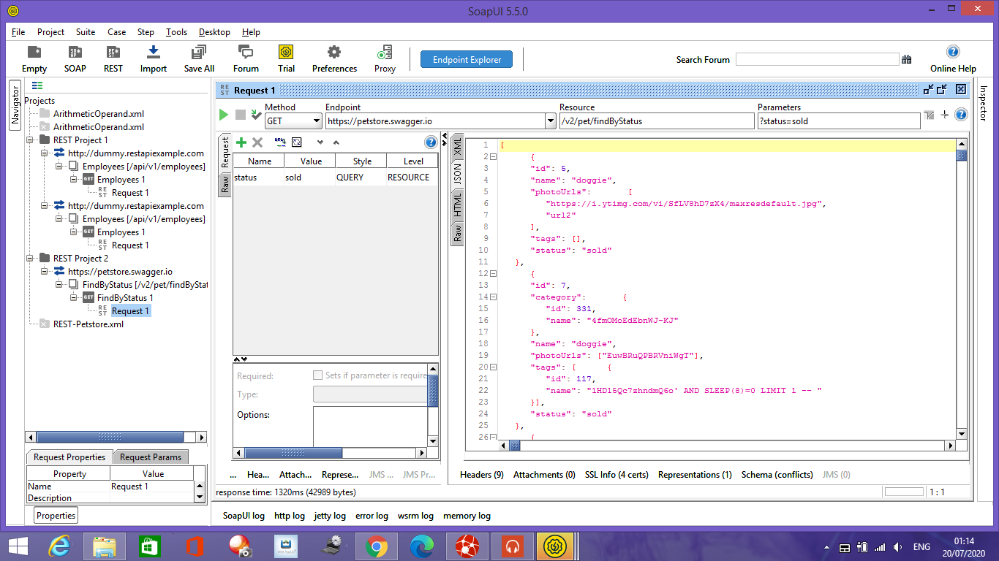
5. SOAP UI, integration testing the API

Slide 7
6. The API EndPoint defined in the Web Application Definition Language (WADL)
<application xmlns="http://wadl.dev.java.net/2009/02">
<doc xml:lang="en" title="http://dummy.restapiexample.com"/>
<resources base="http://dummy.restapiexample.com">
<resource path="api/v1/employees" id="Employees">
<doc xml:lang="en" title="Employees"/>
<method name="GET" id="Employees 1">
<doc xml:lang="en" title="Employees 1"/>
<request/>
<response status="403">
<representation mediaType="text/html; charset=iso-8859-1" element="html"/>
</response>
</method>
</resource>
</resources>
</application>

